Slide 1


Smart Home Automation System Using Arduino.
Presented by :mohd adnan

Slide 2
Introtuction:
Home Automation refers to automatic control of home appliances using electronic systems and sensors.
This project makes a basic smart home system using Arduino UNO and multiple sensors.
Objective: Control a bulb, buzzer, motor, and LED automatically based on sensor input.

Slide 3
Components used:
Component | Description
Arduino UNO | Main controller for sensors and outputs
Ultrasonic Sensor (HC-SR04) | Measures distance to detect objects
PIR Motion Sensor | Detects human movement
LDR (Light Dependent Resistor) | Senses ambient light level
Gas Sensor (MQ2) | Detects gas or smoke
Push Button | Manually triggers the motor
Bulb | Automates light based on LDR
Buzzer | Sounds alarm when motion is detected
DC Motor | Turns ON/OFF with button
LED | Indicates gas detection
Breadboard, Resistors, Jumper Wires | For circuit connections

Slide 4
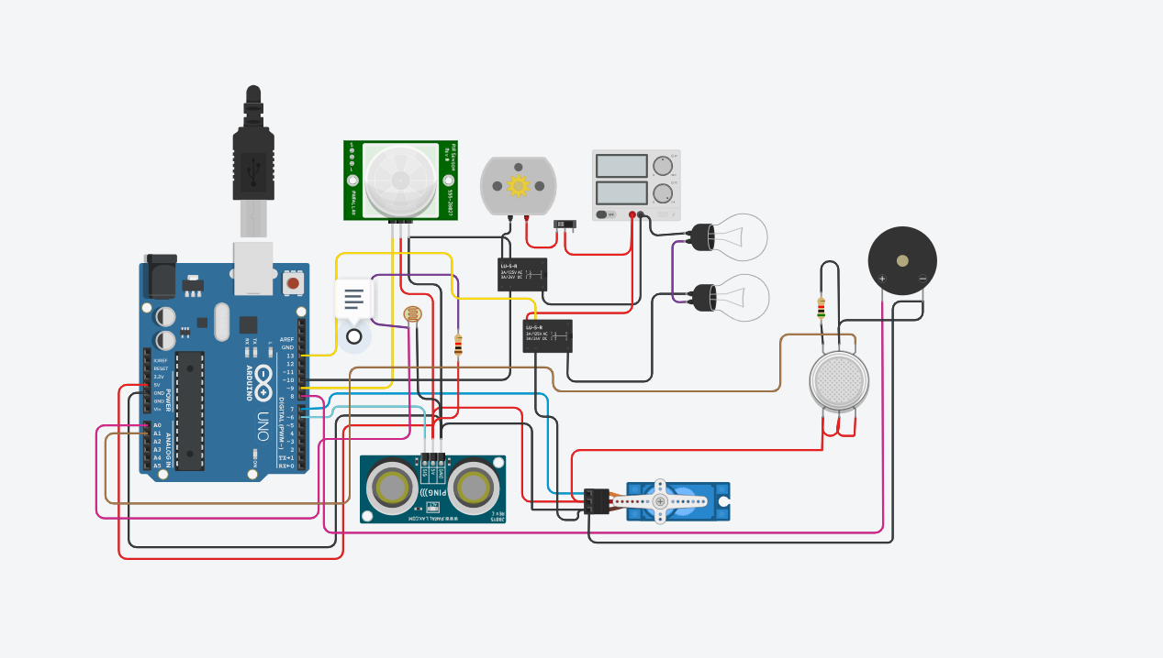
Circuit design:

Slide 5
System working-overview:
This system automates control based on 5 sensors:
Sensor: | Input: | Output Action:
Ultrasonic | Object distance | Door Open
LDR | Light level | Bulb turns ON in darkness
PIR Sensor | Motion | Fan On
Gas Sensor | Gas/smoke | BUZZER ON
Push Button | Manual press | Motor turns ON when pressed

Slide 6
Source code
#include <Servo.h>
// Sensor and device pins
int const gas_sensor = A1;
int const LDR = A0;
int limit = 400;
// Variables
int output1Value = 0;
int sen1Value = 0;
int sen2Value = 0;
Servo servo_7;
// Function to read ultrasonic distance
long readUltrasonicDistance(int triggerPin, int echoPin) {
pinMode(triggerPin, OUTPUT);
digitalWrite(triggerPin, LOW);
delayMicroseconds(2);
digitalWrite(triggerPin, HIGH);
delayMicroseconds(10);
digitalWrite(triggerPin, LOW);
pinMode(echoPin, INPUT);
return pulseIn(echoPin, HIGH);
}
void setup() {
Serial.begin(9600);

Slide 7
pinMode(A0, INPUT); // LDR
pinMode(A1, INPUT); // Gas sensor
pinMode(13, OUTPUT); // Relay (Bulb)
servo_7.attach(7, 500, 2500); // Servo motor
pinMode(8, OUTPUT); // Buzzer
pinMode(9, INPUT); // PIR sensor
pinMode(10, OUTPUT); // Fan (NPN switch)
pinMode(4, OUTPUT); // Red LED
pinMode(3, OUTPUT); // Green LED
}
void loop() {
// ---------- Light Control using LDR ----------
int val1 = analogRead(LDR);
if (val1 > 500) {
digitalWrite(13, HIGH);
Serial.print("Bulb ON = ");
Serial.print(val1);
} else {
digitalWrite(13, LOW);
Serial.print("Bulb OFF = ");
Serial.print(val1);
}
// ---------- Motion Detection (PIR Sensor) ----------
sen2Value = digitalRead(9);
if (sen2Value == 0) {
digitalWrite(10, LOW); // Fan OFF
digitalWrite(4, HIGH); // Red LED ON
digitalWrite(3, LOW); // Green LED OFF
Serial.print(" || NO Motion Detected ");
}
if (sen2Value == 1) {
digitalWrite(10, HIGH); // Fan ON
delay(5000);
digitalWrite(4, LOW); // Red LED OFF
digitalWrite(3, HIGH); // Green LED ON
Serial.print(" || Motion Detected! ");
}
// ---------- Gas Sensor ----------
int val = analogRead(gas_sensor);
Serial.print("|| Gas Sensor Value = ");
Serial.print(val);

Slide 8
if (val > limit) {
tone(8, 650); // Buzzer ON
}
delay(300);
noTone(8); // Buzzer OFF
// ---------- Servo Door using Ultrasonic ----------
sen1Value = 0.01723 * readUltrasonicDistance(6, 6);
if (sen1Value < 100) {
servo_7.write(90);
Serial.print(" || Door Open! ; Distance = ");
Serial.print(sen1Value);
Serial.print("\n");
} else {
servo_7.write(0);
Serial.print(" || Door Closed! ; Distance = ");
Serial.print(sen1Value);
Serial.print("\n");
}
delay(10); // Small delay for stability
}

Slide 9
Output & Observations:
Condition: | Output:
Room is dark | Bulb lights up
Target object Distance | Door Open
Gas leak | Buzzer rings on
Button pressed | Motor runs

Slide 10
Applications:
Smart Lighting – Lights turn ON in dark
Security – Motion detection with buzzer alert
Fire/Gas Safety – Detect leaks and warn users
Home Automation – Automatically control appliances
Energy Saving – Devices run only when needed

Slide 11
Advantages & Future Scope:
Advantages:
Cost-effective
Easy to build
Real-time monitoring
Good beginner project for IoT
Future Improvements:
Add Wi-Fi/Bluetooth module for mobile control
Connect to IoT cloud for data logging
Use voice commands with Google Assistant/Alexa

Slide 12
Conclusion:
Successfully automated various devices using sensors
Shows potential of Arduino in smart home systems
Project is scalable and can integrate with IoT for advanced control

Slide 13
Thank You

